Slide 1
Meaningful Use: Where do we go from here?
Jeffery Smith, M.P.P.
Vice President of Public Policy
CHIME

Slide 2
Overview
A People’s History of Meaningful Use
Current State: Program Year 2014
Future State: 2015 & Beyond

Slide 3
CHIME Is…
CHIME Mission:
Advancing the role of CIOs and senior healthcare IT leaders through education, collaboration and advocacy in support of improved health and healthcare in our communities
Public Policy Vision:
To improve the federal legislative and regulatory environment for health IT through CHIME member expertise

Slide 4
A People’s History of Meaningful Use
A Federal Agency’s View
A Congressman’s View
A CIO’s View
A Patient’s View

Slide 5
A Federal Agency’s View of MU
You are located here
Improved outcomes
Advanced clinical processes
Stage 3
Data capture and sharing
Stage 2
Stage 1

Slide 6
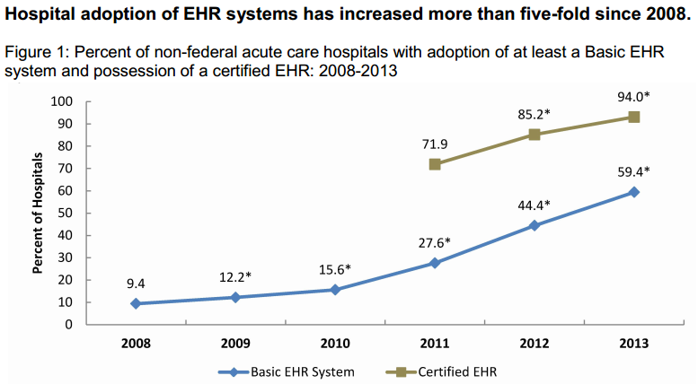
A Federal Agency’s View of MU

Slide 7
A Congressman’s View of MU

Slide 8
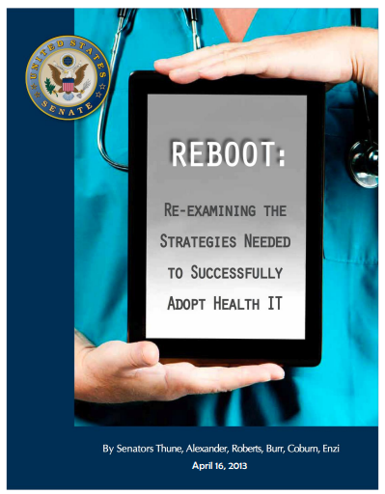
A Congresswoman’s View of MU
2009 – 2012: bi-partisan jubilation
April 2013: REBOOT (aka Show me the Interoperability)

Slide 9
A CIO’s History of MU
Big Bang – $30+ Billion for implementing EHRs and demonstrating its use
Stage 1 = Awesome, helped drive IT agenda and spending to new levels
First audit = *&@$%#
Second Year, Stage 1 = Starting to see benefits of optimizing EHR use
Second audit = *&@$%#
Stage 2 = _________ (Fill in the blank)

Slide 10
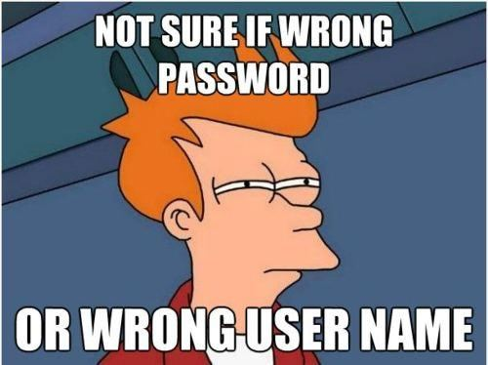
A Patient’s View of MU
Positive View
Negative View
(More) Pervasive use of Web 1.0 technology – e.g. online scheduling, patient portal
Fewer repeat tests
Alerts and reminders
Fewer folders to carry from hospital to physician
Decreased doctor face-time
Multiple patient portals
“Big Brother” fears

Slide 11
Current State: Program Year 2014
More than 90.43% of hospitals have been paid through the EHR Incentive Program
This includes money received for AIU, not the % of hospitals that have met Stage 1 measures and objectives
Data from CMS, April 2014

Slide 12
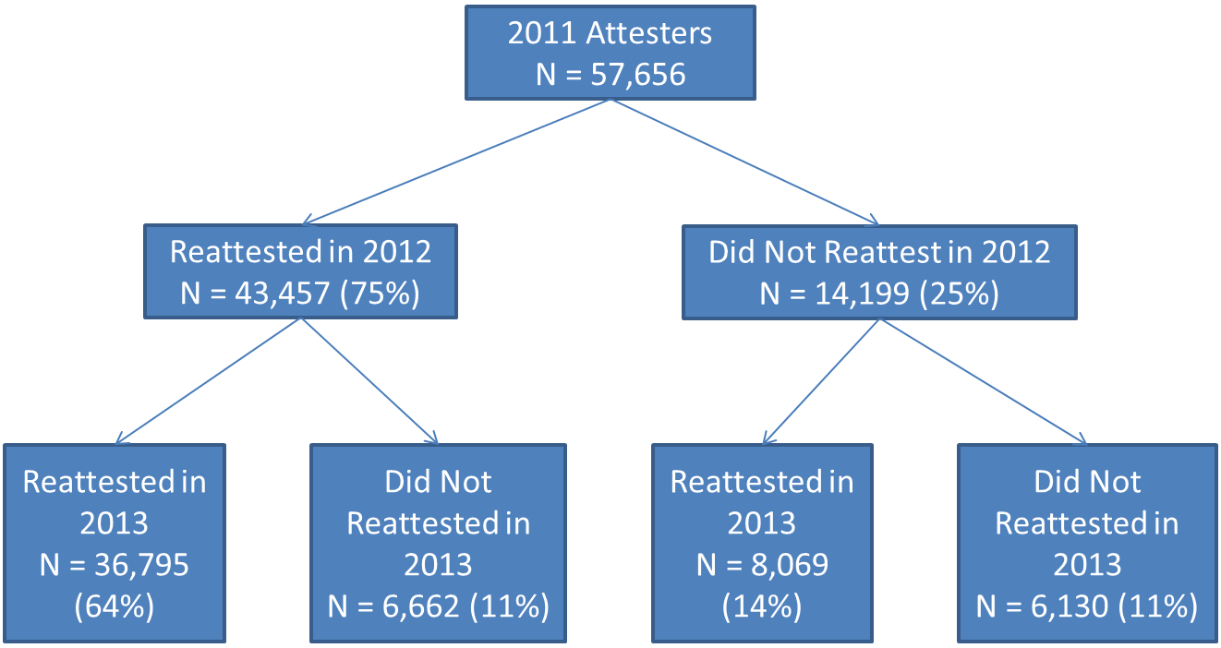
Current State: Continued
Data from CMS, April 2014
22% of EPs have dropped out of the program between 2011 and 2014

Slide 13
Future State: Program Year 2015 & Beyond
Required Stage of MU in 2015 (hospitals)
10 = # of hospitals successful at Stage 2 thus far
Notes:
According to CMS data, 1287 hospitals demonstrated MU in 2013, this cohort will be required to meet Stage 2 for the first time in 2015
1187 hospitals had yet to demonstrate MU as of March 2014
Over 2500 hospitals, just over half of all hospitals, will be scheduled to meet Stage 2, Year 2 in 2015
However, thus far only 10 of those 2500 hospitals have demonstrated Stage 2 so far

Slide 14
Near-term Issues: 2015 Reporting Requirements
Current policy requires 365-day EHR reporting period in 2015, except for those EHs / CAHs and EPs attesting for the first time
Recommendation: “CHIME strongly urges CMS to adopt the 2014 policy, allowing providers to choose any 3-month quarter EHR reporting period, for FY and CY 2015”

Slide 15
Near-term Issues: 2015 Edition CEHRT
2014 NPRM will be published as a final rule in the very near future
Market uptake / impact is as yet unknown
Developer community did not support much of the NPRM
CHIME was lukewarm; asked ONC to wait to develop a CEHRT track separate from MU
Long-term strategy or one-time foray?

Slide 16
Where do we go from here?
Vitality of the program is in jeopardy
MU as eRx
CMS using MU as a “checkpoint modifier” for reimbursement
Quality program reliance on EHR for IQR and PQRS
Congressional pressure
Startup ONC coming of age

Slide 17
Questions?
Contact Information:
Jeff Smith
VP of Public Policy
CHIME
jsmith@cio-chime.org

